Slide 1
CLUB LEADERSHIP
PEARLS
SGA 2023 – 2024

Slide 2
Overview
Sewell Campus Engagement
General Information
How to Become a Club
Club Requirements Details
SGA General Meeting Dates
Funding
Professional Travel
Important Forms & Documents
Submitting a Reimbursement
The How To’s…
Important Contacts
Summary

Slide 3
For Your Information!
You can find important SGA information on Canvas! Within the “Student Clubs and Professional Associations” folder, you can access:
The SGA event calendar
A list of student clubs and professional associations
2023 Virtual Club Fair Video
The Student Club Event Request Form
Forms and Documents
Club Leadership List

Slide 4
Sewell Campus Engagement

Slide 5
Sewell Campus Engagement
To ensure that all students at both campuses have the opportunity to connect with clubs and club activities, we are recommending the following:
All in-person meetings and enrichment events should be offered with a WebEx viewing option. Many rooms on the Stratford Campus now have cameras making this easier!
Also, all WebEx meetings and events should be recorded and provided on request for those that were unable to attend.
Keep in mind that lunch time may not be the best time for all students all of the time; try to vary the times for your club meetings. Tuesdays and Thursdays are generally the best days for lunchtime meetings.

Slide 6
Sewell Campus Engagement
It is important that we all consider how we can add enrichment, engagement and programming to be sure that both campuses have the same experience.
All student clubs should host at least one event OR meeting or event on the Sewell campus this year.
Each club that hosts at least one event or meeting during the year will receive an additional 1 point on their Year End Report and additional programming can earn up to an additional second point.

Slide 7
General
Information

Slide 8
General Information
Clubs and organizations are classified as either SGA-based or non-SGA based entities.
If an organization is SGA-based, the club can designate itself as a non-funded club or as a funded-club upon completion of its two-year probation.
Funded clubs must meet certain requirements each year to receive funding.
A non-SGA based organization is not held to SGA-based club requirements and will not receive yearly funding. They can, however, petition for funding through Alumni Grants and/or Special Projects.

Slide 9
Non-SGA Organizations (Interest Groups)
Organizations that are non-SGA include the Rowan Community Health Center, OMM Clinic, Rowan Surgery Research/Journal Club, Music Medicine, Orthodox Christian Healthcare, The Black Collective and Project REACH.
Non-SGA based organizations/clubs may have individual financial accounts hosted under Student Affairs and they are not held to SGA’s club-status requirements.
They CANNOT receive yearly funding from the annual disbursement.
They CAN petition SGA for an alumni grant and/or a special project funding request.

Slide 10
SGA-based Non-Funded Clubs
Organizations/clubs that are SGA-based and are inactive or probationary do NOT receive funding.
Established clubs that have completed the two-year academic probation and met the requirements set forth by SGA will receive funding based on their year-end report (YER).
Established Inactive clubs are not eligible to receive SGA funding until their status changes to established active and submit a year-end report. They CAN petition SGA for an alumni grant and/or a special project funding request.

Slide 11
SGA-based Funded Clubs
Organizations/clubs that are SGA-based and are established and have met the minimum year-end requirements will receive funding.
Funded clubs will receive their funding from the annual disbursement which are allocated from the Student Activity Fees.
Clubs may be eligible for additional funding, which will be awarded on a point system for each additional category met.
More information about this will be covered on the Year-End Report section.

Slide 12
How to Become a Club

Slide 13
How to Establish A New Club
Before doing anything, you should speak to Dean Micciche and the 1st Vice President regarding your desire to start a new club
These individuals are your best resources for determining if a club already exists (established or inactive) that matches your interests, if starting a recognized club is the proper route for your idea, how to start a new club and if you desire to have your club recognized/established.
For SGA-based clubs, you will need to submit the following:
A Constitution
A petition (list) of at least 5% of the student body (~51 students) that support adding the new club. They do not need to be club members.
These documents must be submitted to the 1st Vice President and Dean Micciche to be reviewed prior to submitting to present to SGA.

Slide 14
Probationary Status
Once a new club is approved, you are automatically placed on probationary club status.
What does this mean?
For two academic calendar years you will not be eligible for funding. However, your club may request funding directly from SGA.
You will be required to submit the YER and fulfill the requirements established for SGA-based funded clubs.
Following the end of two academic calendar years and the appropriate submission of the year-end reports, a vote by SGA will be conducted to approve your club as an official club with funding status.

Slide 15
Reactivating an Established Inactive Club
You must present at the next possible SGA meeting where we will vote if you can become established reactive, which requires you to have
A constitution
A petition (list) of at least 5% of the student body (~51 students)
You must demonstrate that the club is active (hosting events, holding meetings, community service, etc.) for your club to be considered for a vote to become established active.
Email the President, 1st Vice President and Secretary of SGA when you would like to present at an SGA meeting. The presentation will take place during the closed session and will need to be added to the agenda

Slide 16
Club Requirement Details

Slide 17
SGA-Based Funded Clubs Year-End Report Requirements
Active clubs are required to complete the following listed event requirements yearly to receive base funding from SGA and maintain their active status. Active clubs that submit a completed Year End Report are provided baseline funding of $300.
Year-End Report Requirements
Points | # of Events Required | Event Description | Event Examples
1 Point | 1 | Community Service: Event that benefits any entity outside Rowan-Virtua SOM | Includes CARES & Rowan Community Health Center (Community Clean Up, etc.)
 | 2 | School Service: Event that benefits the school in an SGA Organized Event | 99% tabling, Homecoming, Fresh Check Day, Accepted Students Day, etc.
 | ¾ Per Semester | SGA Meeting Attendance | 1 club representative must attend ¾ SGA Meetings on WebEx or In-Person per semester
 | 1 | Student Leader attended Club Leadership Meeting | Held annually, 2 club representatives must attend live & complete the attendance form at the end of this session
2 Points | 3 | Activity Events: 3 Categories 1. General Interest Meeting: Generates interest in club 2. Fundraising Events 3. Non-Service Event: Events that don't meet any of the criteria above | GI: Usually held at the beginning of the academic semester FE: For your club or others within Rowan-Virtua SOM NS: Educational speakers, campus partners collaborations

Slide 18
SGA-Based Funded Clubs Additional Point Information
The more category requirements that you meet the more points you can acquire which will than add on additional funding from the new based funding you will receive. More information will follow about completing your Year-End reports and the scoring system that will be used for 2023-2024.
Additional Point Categories
Points | Event Description | Event Examples
1 Point | Community service: Additional event or events that benefits any entity outside of the University | Includes CARES & Rowan Community Health Center (Community Clean Up, etc.)
 | School Service: Event that benefits the school in a SGA Organized Event, Campus-Wide, Major Events | 99% tabling, Homecoming, Fresh Check Day, Accepted Students Day, etc.
 | OMS Wellness Event: Active Participation in a Student Lead OMS Wellness Event | Friendsgiving, De-Stress Fest, Wellness Week
 | Host event, meeting or program on the SOM Sewell campus | Club events &/or meetings occurring in-person in Sewell

Slide 19
Year End Report Questionnaire Preview

Slide 20
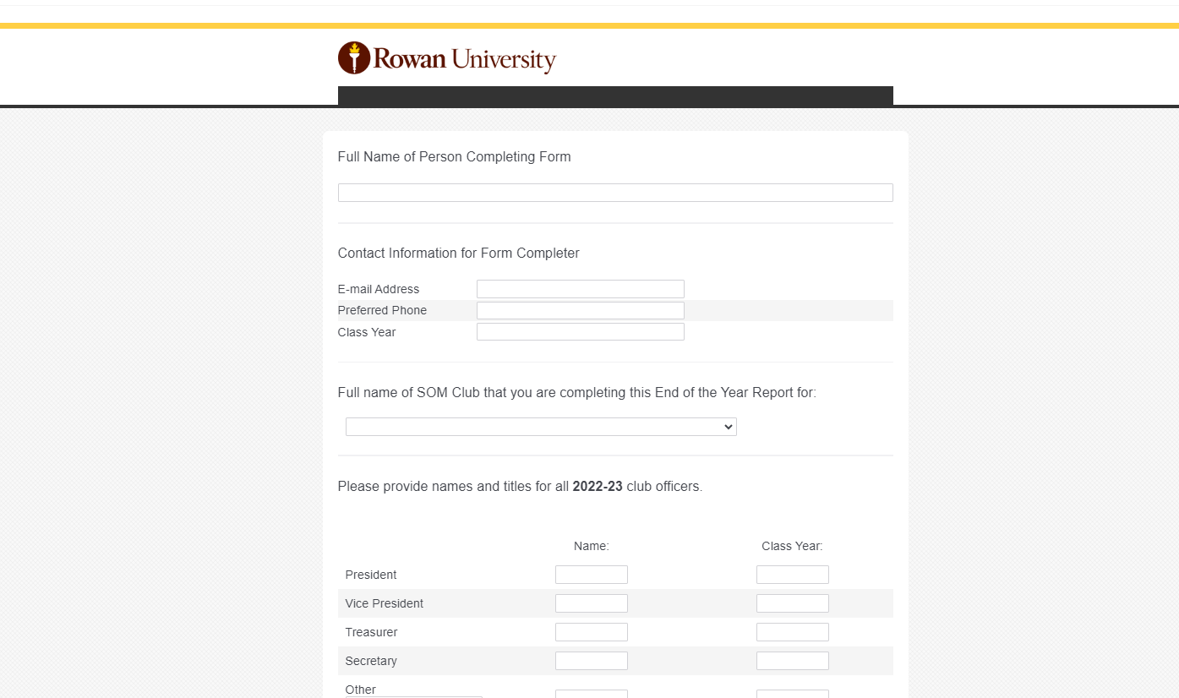

Slide 21
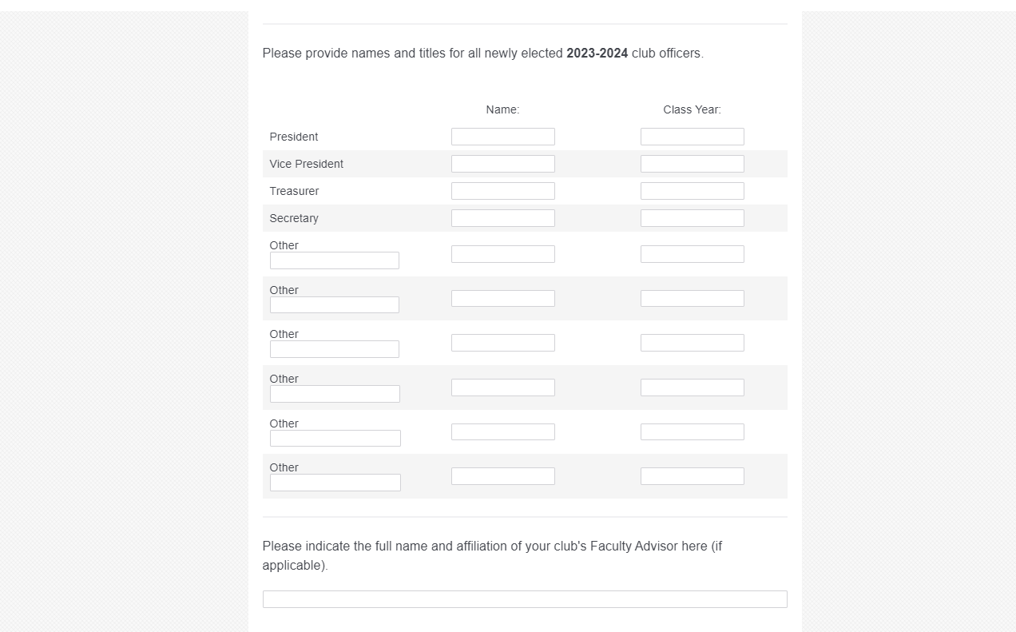

Slide 23
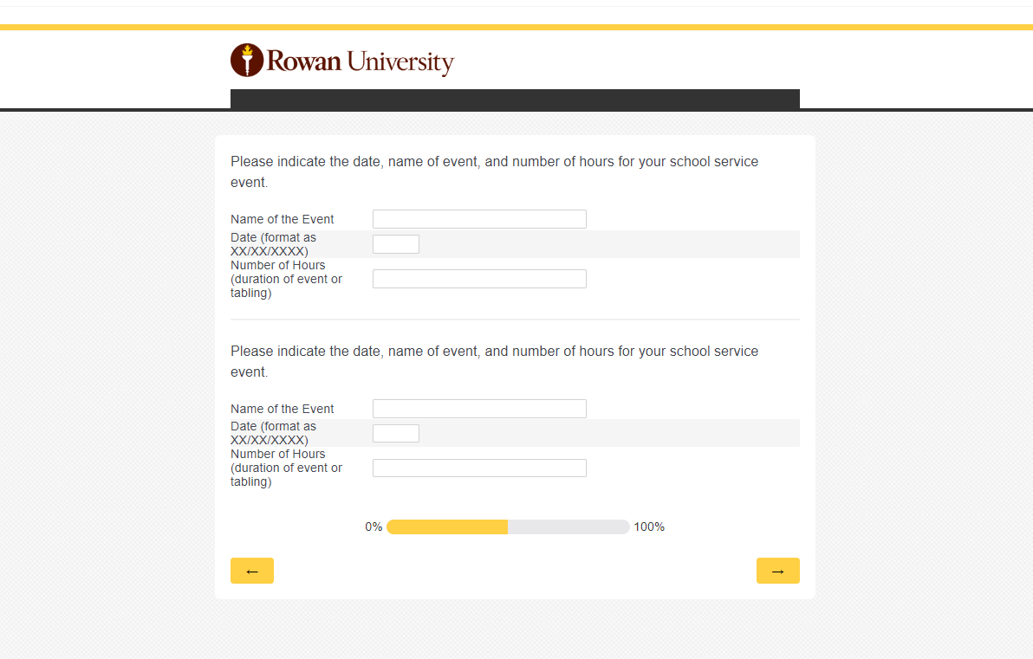

Slide 24
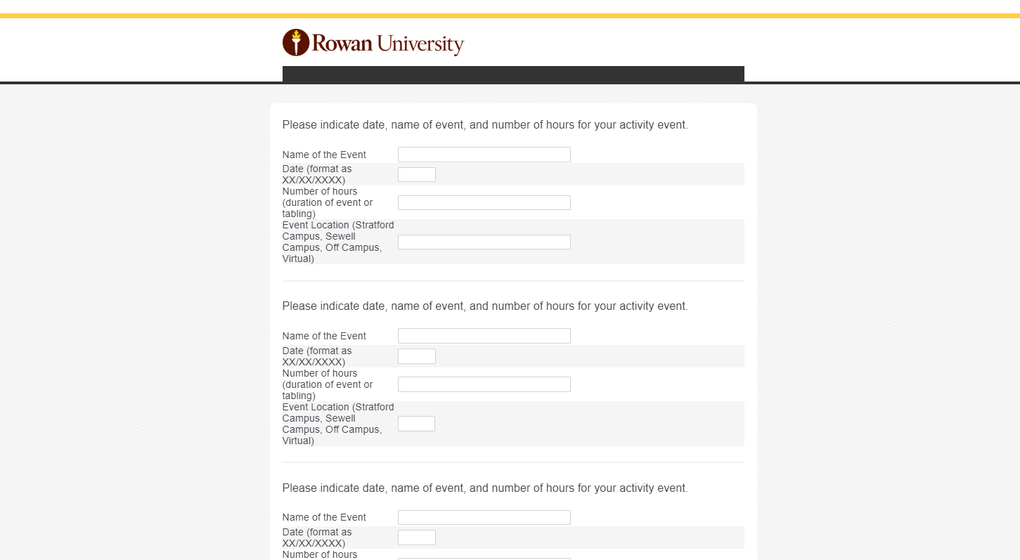

Slide 25
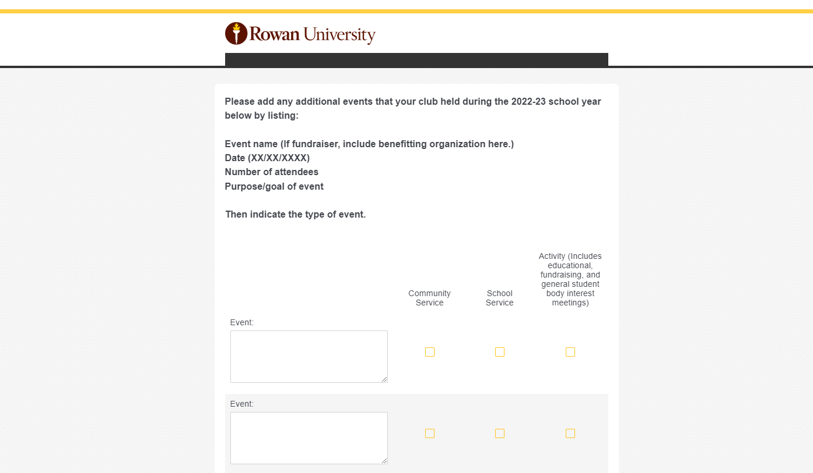

Slide 26
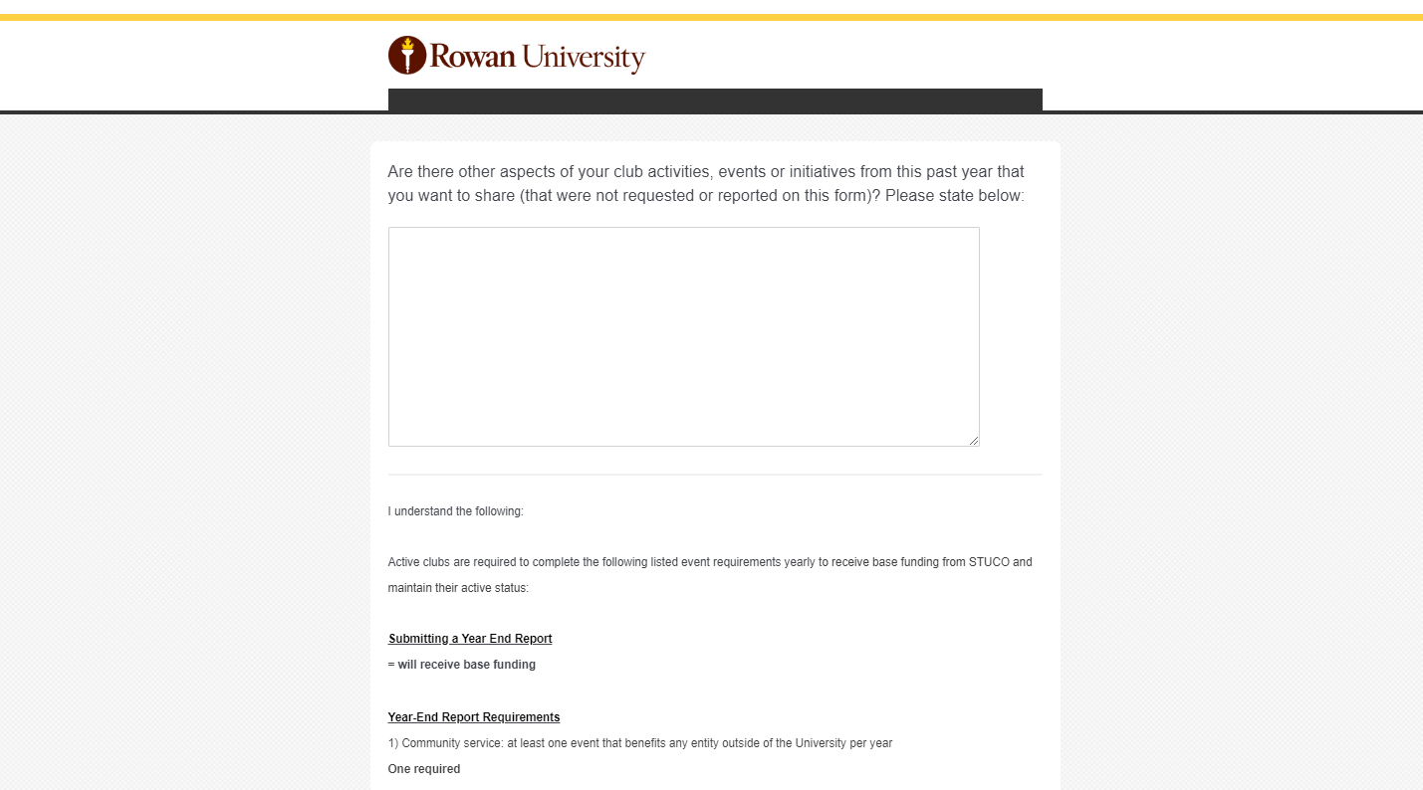

Slide 27
SGA General Meeting Attendance
Student Council Meetings are monthly meetings of student government (includes class and school student council) with the deans and special guests for the discussion of current, relevant topic areas regarding the school and important to the student body. It is a great opportunity for Student Leaders to come together and share information with their fellow students about what news, new initiatives and issues addressed at the school.
Each SGA-based Funded Club is required to have at least 1 representative from their e-board attend the scheduled SGA meetings.
Main role of the appointed representative is to deliver information to their e-board and club members. Club may pick a different person to represent their club for each meeting.
Attendance will be tracked by having a sign-in sheet (form) at the beginning of each meeting.

Slide 28
SGA General Meeting Dates
2023
August 15th
September 19th
October 17th
November 15th
December 12th
2024
January 16th
February 20th
March 26th
April 16th
All meetings will be held at 7:00 pm in the AUD. Meeting information will follow in your email.
Notes:
TBD…

Slide 29
Lounge Cleaning
Every SGA-based funded club and probationary clubs are required to participate in cleaning the lounge.
One club will be responsible for cleaning the Academic Center Student Lounge each week; the schedule will be created and disseminated by the 1st Vice President.
You are expected to clean out the lounge the Friday of your week, emptying the fridges of old food, lunch bags, etc. and wiping down the counters and tables.

Slide 30
Club Closet Rules and Expectations
All clubs are expected to maintain their club storage space in an organized and orderly fashioned. Not maintaining your space appropriately can result in loss of your designated space in the closet and impact your funding. This means that you should occasionally review what is being stored and purge.
All items should be properly stored in a box or container. NO ITEMS should be kept or stored on the floor or on the storage cabinets.
Any club that does not keep their space organized during the year could have their club funding reduced.
Club Closets are located in the University Educational Center (UEC) #1091. This is located on the first floor– follow signs for the Institutional Review Board. Room 1091 is located off the main hall in a separate corridor. Student leaders should all have key access via their student IDs. If you are unable to access the club closets, please see Naomi Mastrocola in Student Affairs.

Slide 31
Funding

Slide 32
Applying for Funding from SGA
In order to apply for funding from SGA, you will need to complete a form based on why you are applying for funding. All funding forms can be found on the SGA website: https://som.rowan.edu/education/studentlife/stuco.html.
You must submit these forms to the President, Treasurer, Secretary, and Stephanie Levin by 5pm the Wednesday before the SGA Meeting. Funding cannot be granted retroactively.
If you are a club/organization interested in receiving funding to travel, you must fill out the document labeled SGA Funding Requests (Conference, Travel, Publication Fees, Etc.
If you need to receive funds for a special project and/or event you can submit for funding by filling out the funding request form labeled SGA Special Projects Funding Requests.

Slide 33
Alumni Grants
Another option to receive funding is through an Alumni Grant, which is a $250 grant that can only be awarded to a club once an academic year.
The requirements of this grant is that the event/program or community service must be made available to all students.
The funds cannot be used for conference or travel-related expenses.
Please fill out and submit an SOM Alumni Grant Request form to be considered for this seed funding. You must submit this form to the SGA President, Treasurer, Secretary and Stephanie Levin at levins@rowan.edu.

Slide 34
Frequently Used On-Line Forms
& Documents
Student Reimbursement Do's & Don'ts
Tax Exempt Letter for NJ Purchases
How the Student Reimbursement Policy Works
Student Reimbursement Policy
Student Reimbursement Request Form
Student Day Travel Expense Form
Student Travel Request Instructions
Student Travel Request Form
Student Travel Waiver Form
Student Travel Expense Form
International Travel Request Form
SGA Funding Requests (Conference, Travel, Publication Fees, Etc.)
SGA Special Projects Funding Requests
SGA Educational Lecture Grant Applications
SGA Alumni Grant Request Form

Slide 35
Professional Travel

Slide 36
Travel Forms: An Overview
Pre-Travel: Students planning to travel for professional development (research, leadership, club-related, medical mission, etc.) must complete and submit the Travel request form and Travel Waiver 14 days prior to travel – these documents should be submitted to Stephanie Levin (Office of Student Affairs). For example, if your travel is on October 26th, then you would submit your paperwork no later than October 12th.
If a student organization/club is planning to attend any meeting or conference, the club’s president should submit a list of potential attendees to Stephanie Levin as early as possible. Stephanie will inform these students of the pre-travel requirements.
Post-Travel: Once travel has been completed, students must submit a Travel Expense form and original receipts to Stephanie within 10 business days of travel to receive reimbursement. These forms must be submitted with all information completed including name, address, Rowan ID number, and purpose of trip. Receipts are required for acceptable expenses to cover your eligible reimbursement amount (the amount that you have been approved to receive).
Please use your own credit/debit card when making purchases for your trip. Any expenses that were not paid for with a Rowan-Virtua SOM student credit/debit card will not be accepted!
Let’s go through the travel process step-by-step!

Slide 37
Step 1: Determine Source of Funding
There are two sources of funding that students can use:
SGA Funding
Club funding
Sometimes students use both funding sources!

Slide 38
SGA Funding Request Process
Email travel funding request form to the SGA President, Treasurer and Secretary. CC Stephanie Levin at levins@rowan.edu.
Submit your travel funding request forms NO less than 2 weeks before your date of travel.
If you have submitted your request two weeks before your travel, then SGA will allow you to present at the upcoming SGA meeting. This may depend upon when the next SGA meeting occurs.

Slide 39
Club Funding
Students have the option to use club funding for their travel.
All club funding requests MUST be shared with Stephanie Levin and Dean Micciche prior to submitting your travel forms. You MUST copy the club president and treasurer for approval.

Slide 40
Step 2: Pre-Travel Process
Once funding is approved, Stephanie will send out an email explaining the travel process.
You will receive a special deadline based on the dates that you are traveling.
Email the completed domestic travel request form and travel waiver to levins@rowan.edu.
If you are traveling internationally, then you must complete the export control checklist and CITI training.
Again, all travel paperwork must be submitted no later than two weeks prior to when travel is taking place.

Slide 41
Step 3: Post-Travel Process
Please submit your travel expense form, itemized receipts, and a copy of your debit/credit card within 10 days after your travel has taken place.
Stephanie will reach out to you by email if you are missing any important paperwork.
The Expense Report Tips document will assist you with what paperwork will be required for travel reimbursement!

Slide 42
Submitting a Reimbursement

Slide 43
What Items Cannot be Reimbursed
Anything that can be purchased via Amazon must be purchased on Amazon! Stephanie Levin will order items directly from your club account.
Per Rowan University policy, gift card reimbursements are prohibited!
Rowan University prefers paper plates, forks, and knives to be purchased through our department’s Amazon account.
School or office supplies are to be purchased through our department’s Amazon or Office Depot accounts.
If you would like to create signs for an event, please utilize the SOM Learning Technologies & Media or the Rowan University Print Center.
If you are unsure about a purchase or want to confirm if a purchase is reimbursable, contact Stephanie Levin.

Slide 44
Food Purchases
Food Items purchased over $100.00 must have a Gourmet Dining Waiver submitted 2 weeks prior to the event.
Contact Stephanie Levin to initiate the waiver process.
Pizza purchases do not require a Gourmet Dining waiver at any cost.
The waiver applies to food items purchased for over $100.00 on Amazon and from the supermarket.
All food and catering items purchased under $100.00 do not require a Gourmet Dining waiver!
No waiver is required for any food purchases for events held at the Sewell Campus.
Rowan University is tax exempt in the state of New Jersey, and we are happy to provide you with a copy of the tax letter to provide to the restaurant should they accept it.

Slide 45
Reimbursement: Step 1
Email your reimbursement request form, itemized receipts, and a copy of your debit/credit card showing only your name and the last four digits to levins@rowan.edu.
Your itemized receipts must show the last four digits of your credit/debit card and the list of items that you have purchased.
Items purchased with a debit/credit card that is not in your name will not be reimbursed.
All reimbursements must be submitted within 45 days after the purchase has taken place.
Reimbursements submitted after the 45-day period will not be accepted!

Slide 46
Good
Bad

Slide 47
Reimbursement Step 2
Stephanie will reach out to both the president and treasurer of your class or club by email to obtain approval for your purchase.
Once Stephanie obtain both approvals, she will prepare your reimbursement.
Associate Dean for Student Affairs will review and approve your reimbursement. If additional information is needed,
Stephanie will reach out to you by email!

Slide 48
Big Changes!
Voiceover presentations
The presentations will cover ALL processes regarding travel, reimbursements, Amazon orders, etc.
I welcome any feedback regarding the presentations once they are released!
I also encourage student leaders to make an appointment with me to discuss class and club finances. I am now a part of the Starfish scheduling system, so please feel free to make an appointment with me!
I am located in the University Educational Center, Suite 2105, Office 2139.

Slide 49
The How-To’s

Slide 50
Club Event Planning Process
1. Confirm Event Details (Date, Time, Location)
5. Promote Event (Social Media, Sunday News, Automail)
2. Submit Student Club Event Submission Form (Allow 10 business days for approval)
4. Determine Catering Needs and/or Set-Up Needs and Submit Any Necessary Requests
3. Submit Room Reservation Request Form (In-Person events only)

Slide 51
Procedure for ALL Event Approvals: Virtual, Hybrid and In-Person
All events held virtually or on any campus of Rowan University must be registered for review and approval through the Office of University Events. No events may be held without University approval.
A representative from the club responsible for the event must complete the Student Club Event Submission Form. A Student Affairs team member will submit your event request to University Events for final approval. Please allow 10 business days for approval. Once the event has been approved, the club representative will receive a confirmation email.
Please allow ample time for the approval process when planning your event.

Slide 52
Student Club Event Submission Form
The Student Club Event Submission Form can be accessed here: https://docs.google.com/forms/d/e/1FAIpQLSf_QqnR2FUOOxldPs3qTzdLRJpDDh3tjH2OuJ8lujIGtaiZtg/viewform.
By filling out the Student Club Event Submission form, your event will be:
1. Submitted to University Events for final approval 2. Added to the SGA calendar following University Events approval 3. Tracked for the SGA year end reports
Once your event is approved through University Events, your event will automatically populate to the SGA Calendar, which can be accessed here: https://calendar.google.com/calendar/embed?src=rowanSGA%40gmail.com&ctz=America%2FNew_York.
You can access the Student Club Event Submission Form and SGA Calendar in each edition of the Sunday News, in Weekly Wellness Resources Newsletters, and on Canvas in the “Student Clubs and Professional Associations” folder.

Slide 53
How to Reserve a Room
Please follow this link and fill out the information request at least two weeks prior to your event: https://som.rowan.edu/education/studentlife/reserve.html
Use the information box to give specific details about your reservation request.
Students can check if a room appears available through 25Live: https://25live.collegenet.com/rowansom.
Note: Even IF a room appears available, there is no guarantee until the room reservation is submitted and confirmed. It is helpful to include alternate rooms in your request.
WAIT until your receive email confirmation from Naomi that your room is reserved.
Reservations can take up to 72 hours to be processed.
Note: Approval of a room reservation does not signify approval from University Events of your event and vice versa.

Slide 54
How to Request AV & Print Support
Please note that MOST rooms within the Academic Center will allow you to have access to a projector, laptop/computer, and microphone.
If you have a need for any AV equipment for your event that is not already provided to you, send your request to Brittany Quintana at quinta02@rowan.edu.
Design & Printing Needs (Posters/flyers) – Send your request to Brittany Quintana at quinta02@rowan.edu for final submission. There are no costs associated with design work, but there are costs associated with printing requests. Costs will come directly from your club account.
Please allow at least five business days for your A/V, design and print requests.

Slide 55
Student Club Tabling
If you only want to reserve a table/chairs in the Atrium or UEC, please submit a table request to Naomi Mastrocola in Student Affairs at spinanr@rowan.edu.
If you only want to reserve a table/chairs in the student lounge area at Sewell, please submit a table request to Brittany Mitchell in Student Affairs at mitchellba@rowan.edu.
At least five business days notice is required for these requests.

Slide 56
Large Meetings & Events
Please contact Brittany Quintana in Student Affairs at quinta02@rowan.edu (Stratford) or Brittany Mitchell in Student Affairs at mitchellba@rowan.edu (Sewell) for assistance with:
Larger catering orders/quotes through Gourmet Dining
Extensive room set-ups
Detailed floor plan designs
Campus-wide marketing/promotions
AV needs

Slide 57
Club-Hosted Conferences
Please contact Brittany Quintana at quinta02@rowan.edu if your club is exploring hosting a conference.
You should NOT confirm any plans without first connecting with our office, as there are several University requirements to host a conference on campus.
It is important to also consider room reservations and budgets before confirming any plans for a conference.
Allow ample time for planning, as University requirements will need to be met before you can proceed with planning.

Slide 58
Internal Food Orders
Please contact Brittany Quintana in Student Affairs at quinta02@rowan.edu (Stratford) or Brittany Mitchell in Student Affairs at mitchellba@rowan.edu (Sewell) for assistance with food orders.
You can order catering for your event directly through Gourmet Dining, the on-campus caterer.
This expense would come directly out of your club budget.
Your order must be submitted at least FIVE days prior to your event and is considered fully confirmed THREE days prior to your event.
All internal Gourmet Dining orders will be submitted by Brittany Quintana for Stratford and Brittany Mitchell for Sewell.

Slide 59
External Food Orders - Stratford Campus
Please contact Brittany Quintana in Student Affairs at quinta02@rowan.edu (Stratford) for assistance with external food orders.
External food orders are capped at $100.
Any external food order over $100 will require an approved waiver to be eligible for reimbursement.
Please allow ample time for pre-approvals if you plan to include food at your event.
You should not pay for any external food orders over $100 without an approved waiver as they will not be reimbursable.

Slide 60
External Food Orders - Sewell Campus
Please contact Brittany Mitchell in Student Affairs at mitchellba@rowan.edu (Sewell) for assistance with external food orders.
The waiver requirement does not apply to the Sewell Campus.
You can place an order with Giofano’s Italian Bistro, a local caterer that works closely with the Sewell Campus. While this is an external order, the expense would come directly out of your club budget with a purchase order.
You can otherwise order from any restaurant of your choosing and submit for reimbursement. Your order does NOT have to be capped at $100 or require an approved waiver to be eligible for reimbursement.

Slide 61
WebEx Meetings vs. WebEx Webinars
WebEx Meetings are ideal for smaller meetings or programs with face-to-face interaction, while WebEx WEBINARS are ideal for larger events or panel events where you want to highlight the speaker(s) only and allow interaction via submitted questions.
Both can be easily set up on your Rowan WebEx dashboard!
If you need any assistance, please contact Brittany Quintana at quinta02@rowan.edu.

Slide 62
Club Event/Sales Promotions
If you’d like your event/meeting, announcement, fundraiser/sale, or general information shared with the student body, please email the Secretary of SGA (ahmedn88@rowan.edu) with the subject line “Sunday News” by 5 pm the Saturday before the email is posted on Sunday. If you’d like an image attached, please submit in jpg form.
You can Facebook or GroupMe as a way to communicate with the student body.
As a reminder, you cannot use class email lists for club announcements. Exceptions have been granted, but you must request it. Requests to email to any of the student class email lists should be sent to Dean Micciche.

Slide 63
How to Request an SOM Automail
Automail email requests are only permitted for events/fundraisers applicable to the entire campus – including faculty, staff, and GSBS students – and are handled on a case-by-case basis.
Email Brittany Quintana at quinta02@rowan.edu a short write-up of information about your event/what you want sent. Attachments will need to be hyperlinked within the body of the email.
This should be done at least five business days prior to the day you want the email sent.

Slide 64
TV Monitor Announcements
Any announcements by student groups must receive prior approval from the Office of Student Affairs and Alumni Engagement.
To submit a request for a TV monitor announcement, please submit an email to Brittany Quintana at quinta02@rowan.edu with the following information:
A brief description of your announcement (text is limited to 10-15 words)
Any approved graphics or photo, ONE image will be selected for use
When you would like the announcement to run
Please submit your request at least three weeks prior to your event and remember to allow time for the announcement to be designed.

Slide 65
Requesting Review for an Imprint or Logo Design
Students seeking to purchase imprinted merchandise or apparel for their club should send their logo/print request to the SOM Marketing Dept. Only the Marketing Dept. can approve logo designs that include the Rowan University or Rowan-Virtua SOM brand.
Requests should be submitted to Lynne Yarnell (falchelm@rowan.edu) and also copy Jerry Carey (careyge@rowan.edu) and Dean Micciche (miccicda@rowan.edu).
NO merchandise with the Rowan University or Rowan-Virtua School of Osteopathic Medicine logo should be ordered or advertised without this approval.
Even though a design was approved in the past does NOT mean it is approved now!

Slide 66
Hosting a Collection or Drive
Clubs seeking to host a collection or drive should contact Naomi Mastrocola (spinanr@rowan.edu) to request collection bins. You should provide at least one week’s notice for your request. Please note requests are on a first come, first served basis. You can check the SGA Calendar for available weeks.
Bins can be placed in the UEC second floor lobby, the Academic Center Atrium and/or the Sewell Student Lounge.
Collections and drives will run for NO MORE than two weeks total, beginning on a Monday and end on a Friday. Please ensure your signage is removed and donated items are cleaned out when your collection or drive is over so that they are ready for the next club’s use.
Club representatives are responsible for properly labeling the bins and actively checking the bins to ensure that donated items do not overflow outside of the bins. You can have an 11” x 17” color sign printed for just $4!

Slide 67
Hosting Wellness Initiatives
Campus events that promote wellness and balance.
Same event approval process applies. Complete the event approval form and select “wellness events”
Contact us if your club is interested in:
Wellness/fitness activities
Boosting morale
Promoting mindfulness
Breaking the stigma of “getting help”
The Office of Student Affairs and Alumni Engagement would love to collaborate with club leaders for wellness programming!
Contact Brittany Mitchell at mitchellba@rowan.edu and
Alexis Scott at scotta7@rowan.edu for more information.

Slide 68
Important
Contacts

Slide 69
Student Affairs Contacts
Brittany Quintana, quinta02@rowan.edu
Stratford Student Events/ University Events
Brittany Mitchell, mitchellba@rowan.edu
SOM Wellness Programming/ Student Health Insurance/ Sewell Events/ University Events
Alexis Scott, scotta7@rowan.edu
Stratford Wellness Programs/ Social Media/ Yearbook
Stephanie Levin, levins@rowan.edu
Club Governance/ Finance/ Student Travel/ Student Reimbursements
Naomi Mastrocola, spinanr@rowan.edu
Room/Table Reservations/ Club Leadership Directory/ White Coat Sales

Slide 70
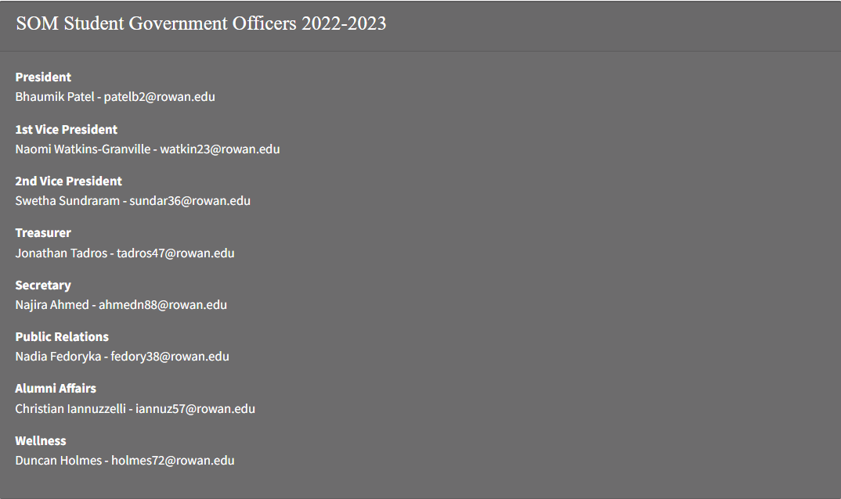
SOM Student Government Contacts

Slide 71
Summary
Keep the Sewell Campus in mind when planning your meetings and events.
Room reservations must be made online! Make your reservation at least 2 weeks before your program or meeting.
Use the Sunday News, class Facebook pages, and GroupMe to promote your events.
Keep your club storage area neat and organized!!
There are base requirements for SGA funded clubs to receive funding, but there are opportunities to earn additional funding to reward more active clubs.
Please contact the 1st VP and Dean Micciche if you are interested in starting up a new club.

Slide 72
Summary
Contact Stephanie for all things concerning your finances of the club, travel documents, purchases, waivers and/or reimbursements. When in doubt, ask Stephanie.
All travel forms for funded travel must be submitted 14 days prior to the date of travel to Stephanie. You have 10 days from the day you return home from traveling to submit your travel expense form.
If you need to make a purchase or if you need supplies for an event, please send the Amazon links to Stephanie Levin at levins@rowan.edu to be purchased via your club account. Please all 7-10 days for this process.
If you have any questions, feel free to contact the 1st VP at any time! Send an email with the subject line “Club 23-24” to watkin23@rowan.edu.

Slide 73
Questions?

Slide 74
THANK YOU!
Join our SGA Eboard GroupMe: https://groupme.com/join_group/70134034/3p9HulIY
DON’T FORGET TO FILL OUT THE ATTENDANCE FORM

